Slide 1
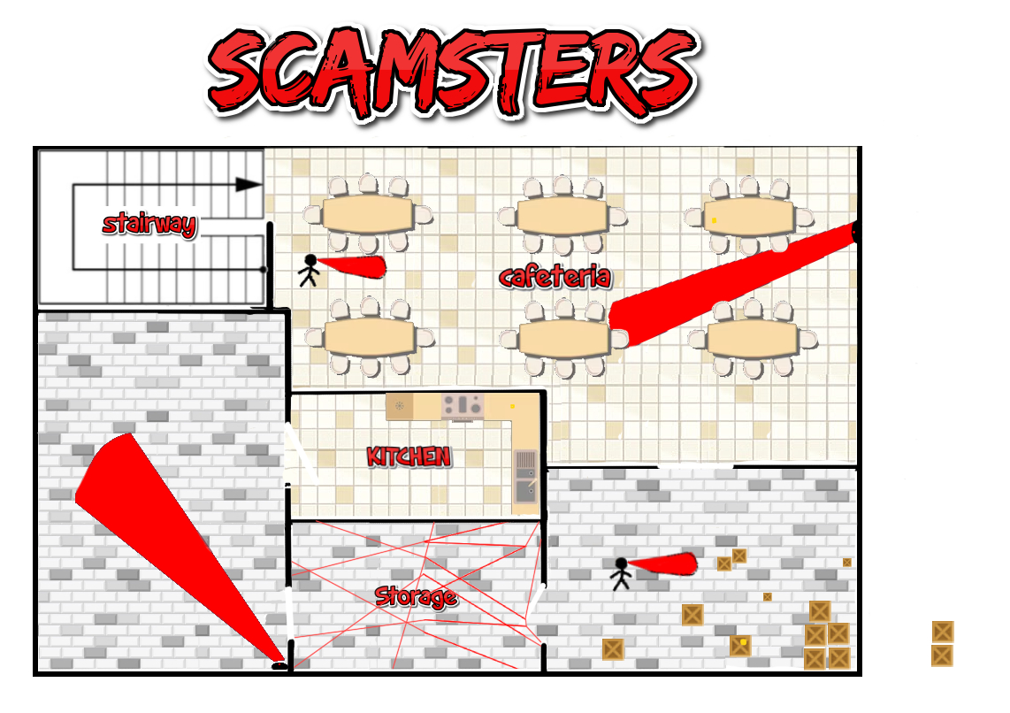



Scamsters Ground Floor Map
Security guard that paces left to right that the player needs to dodge to get the code in the room.
This sticky note will tell you the code to open the storage room
Sticky note with a code which will open up the door to office 1
Some doors will be open therefore will not need a code/key
Security Camera that can spot you and will sway right to left so you could dodge the area and get past it
Security guard that paces left to right that the player needs to dodge to get the code in the room.
Security Camera that can spot you and will sway right to left so you could dodge the area and get past it
This sticky note will tell you the code to open the cafeteria room
Lasers that trigger something when the player collides with them.

Slide 2
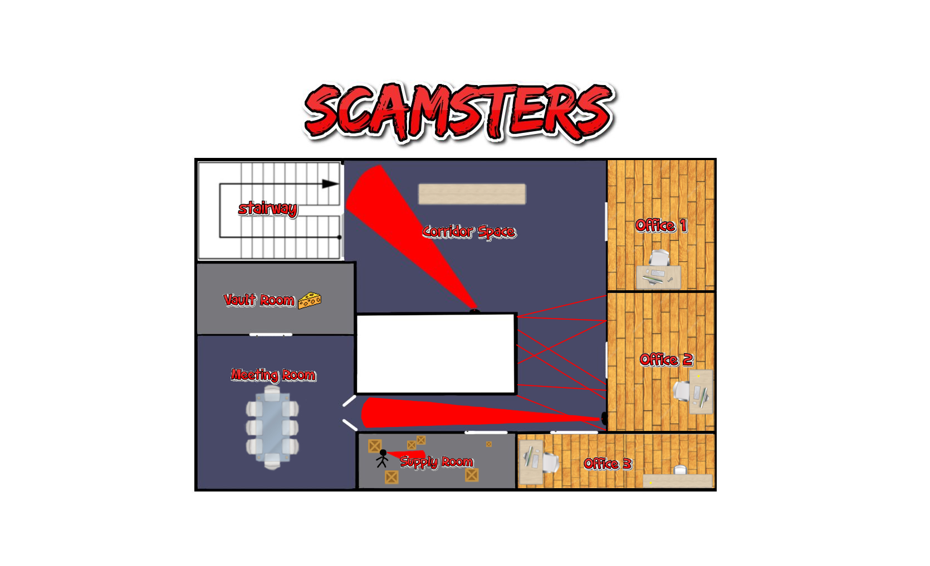
Change this if you want:
Office 1 key opens Office2.
Office 2 code unlocks Supply Room.
Supply Room code unlocks Office 3.
Office 3 key unlocks one of the Vault Room locks.
Scamsters 2nd Floor Map
Maybe one of the locked doors only opens enough so that only the rat can squeeze through?
Camera that sways left and right to monitor the larger area of the office space.
Long object in the lobby space so that the player can get past the camera.
Key on the desk which is required to open certain locked doors.
Lasers that trigger something when the player collides with them.
Two combination locks on the vault door that you need a code from each floor for. Maybe even a code that only the rat can get and a code that only the human can get?
lrs;0;[137]
Sticky pads with codes on them which are used to unlock combination locks and then open doors.
A second security guard that walks around the table.
Security guard that paces left to right that the player needs to dodge to get the code in the room.
Camera that flickers on and off. The player will have to time it right to get to the room and then the end.
Locked doors with little grey blobs on them are doors that need a codes to unlock.

